Slide 1
Session 1.1 - Introduction
IN705 Databases 3 – 2018

Slide 2
Teaching Staff
Nathan Rountree
D303a
nathan.rountree@op.ac.nz
Slack channel: databases_3_2018

Slide 3
Session Times
Stream B: Tuesday 3-5 D313 Thursday 8-10 D313
Stream A: Wednesday 1-3 D105b Friday 1-3 D105b

Slide 4
SQL Accounts
Server: fthictsql04.ict.op.ac.nz
Username: your OP username
Password: will be provided over Slack

Slide 5
3rd Year Papers
Higher workload
Greater emphasis on theory
More independent work
More academic (creative) work
More reading
Notes:
For some of you, this is your first third year paper.
There are some differences between 2nd and 3rd year expectations, and we don’t want them to come as a surprise
greater emphasis on theory, and how that makes the skill set portable. This is reflected in the assessment structure, where the theory exam is worth 25% of your total mark.
Mention importance of keeping up with the reading.
All of these things should make your 3rd year more exciting and rewarding than the previous ones, but you have to be prepared to do the work. Don’t put things off to the end, don’t underestimate how much effort is required if you plan to achieve a high level of performance.

Slide 6

Why Databases Matter
Information
Knowledge
Truth
DB!!
Notes:
Database development is sometimes treated as the poor guy’s programming.
Part of software development, but not as cool or clever or creative.
In some ways, this is true. Compared to straight programming, DB work is much more mechanical and rote – all databases are much more alike than are all programs.
However, database work can be quite interesting and challenging, and it is really, really important.
Let’s think about what role databases play….
Somebody, somewhere has collected a lot of facts. They’ve done a research project, or they’ve run a survey, or they’ve just collected a lot of random stuff.
What they have is data. Sometimes LOTS of data. And it is of almost no use to them
What they need is Information, Knowledge, Truth
And one of the things that helps them get that is Databases
A well-implemented database will organise and structure the data so that people can understand it better.
It will enable them to ask questions of it, compute summaries about it, and find patterns in it, all easily.
That’s your goal; remember it when you feel that you’re slogging through one more dreary SQL multiple join…

Slide 7
Schedule
Refer to course descriptor for session details
General structure:
Database development
Conceptual Design: Reality => ERD
Logical Design: ERD => Relational schema
Physical Design: Performance tuning
Application Development
Database Research
Database Administration
Notes:
Discuss why we will revisit modelling, even though they’ve done it before. That’s the hard part to learn, so you need to practice it. In a 3rd year paper, you will 1) learn more theory, 2) solve harder problems, 3) work more independently, and 4) consider solutions more analytically
Note that we will be translating our conceptual model (ERD) into relational schemata, but there’s no rule that says we have to. We could, if we felt like it, translate to XML, or to an OO system. The conceptual model is language and DBMS independent. It simply reflects the important bits about the client’s data universe.
When we talk about physical design, we will be looking into some of the deep implementation details, for example, considering the complex data structures that modern DBMSs use to implement indices.
It’s possible that you could spend your life working with DBs and never need to know this, but if you’re looking for a deeper understanding, with the possibility of moving beyond the vendor-supplied, this kind of knowledge is power

Slide 8
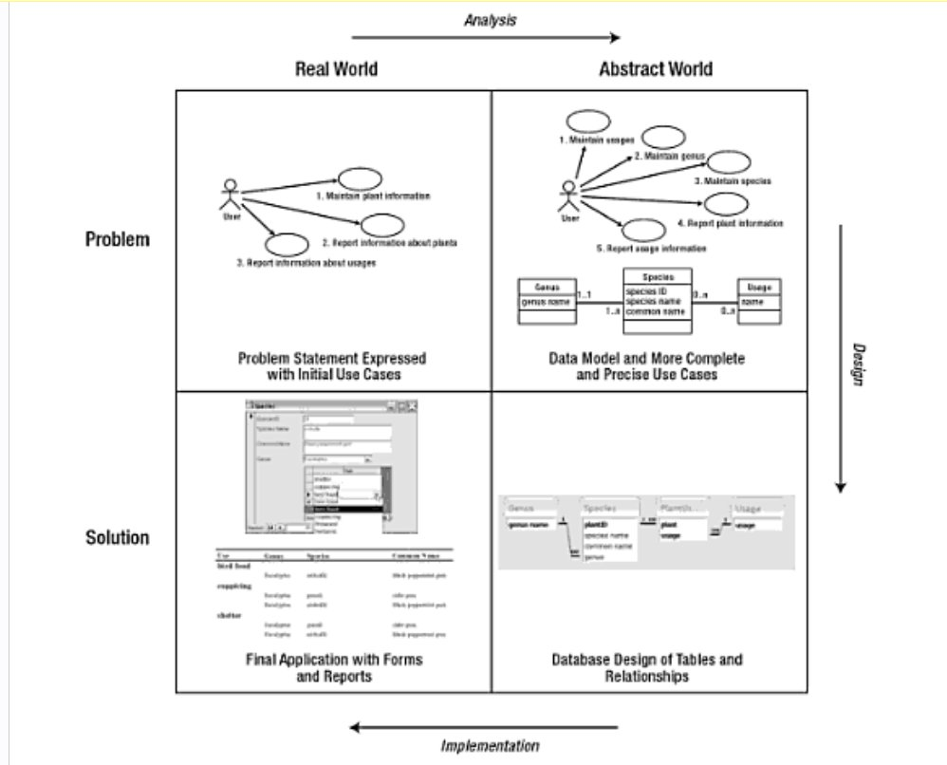
Development Life Cycle
Notes:
Development Life Cycle, from Churcher
This first part of the paper follows this standard SDLC.
This figure from Churcher – we’ll talk about books in a bit

Slide 9
Schedule
Week | Date | Session 1 | Session 2
1 | 23-07-18 | Introduction | SQL Review
2 | 30-07-18 | Conceptual Modelling | Logical Modelling
3 | 06-08-18 | Assignment 1 work time | Assignment 1 work time
4 | 13-08-18 | Assignment 1 work time | Assignment 1: presentation
5 | 20-08-18 | Advanced SQL 1 | Dale’s day
6 | 27-08-18 | Advanced SQL 2 | Performance: Physical design
7 | 03-09-18 | Performance: Query Optimisation | Performance: Tuning
8 | 10-09-18 | Application Dev 1: Interface design | Application Dev 2: Front end tools
9 | 17-09-18 | Application Dev 3: Project spec | Transactions and Locking
10 | 24-09-18 | Data Warehousing and Mining | GIS and spatiotemporal DBs
Midterm Break
11 | 15-10-18 | Non-relational models 1 | Non-relational models 2
12 | 22-10-18 | DBA1: Duties | DBA2: Installation
13 | 29-10-18 | DBA3: Users and privileges | DBA4: SQL for DBAs
14 | 05-11-18 | DBA5: Backup and recovery | DBA6: Database Security
15 | 12-11-18 | High Availability and Reliability | Assignment 2 demos
16 | 19-11-18 | Exam revision session | Final exam
Notes:
See the full course directive on the I:drive
Be aware that this schedule is subject to change, in case we decide to spend more or less time on a particular topic

Slide 10
Assessment
Modelling 15%
Application 40%
Labs 10%
DBA pracs 10%
Theory Exam 25%
Notes:
You can find more details about due dates, etc. in the course descriptor (on I drive)
And there will be detailed specs provided for the two projects
The Model and Application are development projects
Labs are in-class check-offs
DBA and Theory exams are during the two sessions of the last week

Slide 11
Tools
Visio (or equivalent)
SQL Server 2016
Visual Studio or Access
Notes:
For making tidy diagrams
For implementing our databases
For building our application front ends

Slide 12
You Should Remember From DB2…
The Entity-Relationship model
ERD notation
The relational model
Relational schema notation
SQL
SQL Server Management Studio
Notes:
...and if you don’t you should review
We will spend the first few sessions in revision
We will start today by going very briefly through the definitions, just to make sure we are all clear

Slide 13
Entity-Relationship Model
A language-independent and DBMS-independent method for modelling a system.
The model consists of entities and the relationships between them.
Don’t confuse “relationship” and “relational”
Notes:
The “relational” model is a completely separate thing; we will get to that in a few minutes
NB: We will be converting our entity-relationship models into relational databases, but that’s not a requirement.
We could convert them to XML or OO if we were using a different database tool.

Slide 14
ERD Notation - Crow’s Foot
Relationship
Entity
Entity
Notes:
We need some formalism for diagramming our ER models.
There are several you can choose from. We will look at two common ones today.
The most common is this one, “Crow’s Foot”.
Boxes for entities, lines for relationships

Slide 15
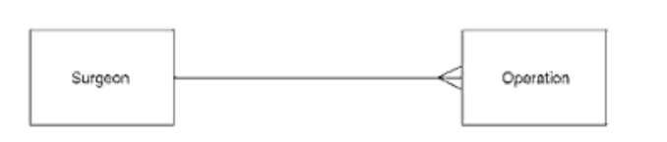
ERD Notation - Crow’s Foot
Cardinality
From Simsion & Witt
Notes:
Relationships differ in their optionality (if they have to happen for every entity instance) and cardinality (how many instances of the relationship can exist simultaneously)
There are diagramming conventions to represent this.
The first, cardinality, expresses how many instances of the relationship might exist for a single instance of an entity
Denoted by the shape of the line where it touches the box. Single = 1; crow’s foot = many (more than 1)
Surgeons and operations. “A surgeon performs many operations; an operation is performed by one surgeon.
Note that this model doesn’t allow for multiple surgeons. That might be correct, or it might not.
We will discuss such things next week when we talk about data modelling

Slide 16
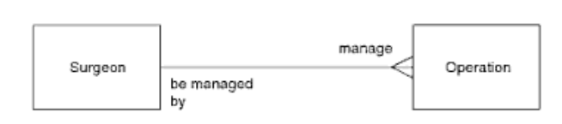
ERD Notation - Crow’s Foot
“Naming” the relationship
Notes:
To clarify, we can label the line…
Usually one passive and one active for the two directions of the relationship

Slide 17
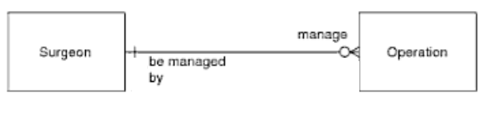
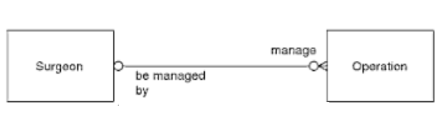
ERD Notation – Crow’s Foot
Optionality
Notes:
What about when participation in a relationship is optional? For example, what if there are surgeons who haven’t performed any operations?
To indicate the optionality (the required minimum number of participants, place a 1 or a 0 on the line, inside from where it touches the box.
Simsion likes the “may” or “must” description. More often “may” = “0 or more” and “must” = “1 or more”
Top: Each surgeon may manage 0 or more operations, each operation is managed by exactly one surgeon
Bottom: Each operation is managed by 0 or 1 surgeon (so it may not be managed by a surgeon at all…..)
Note that there is no inherent right or wrong here. It depends on the reality you are describing.

Slide 18
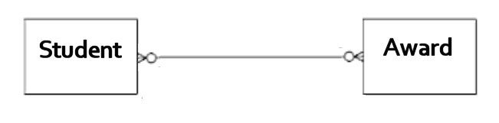
ERD Notation – Crow’s Foot
Notes:
How would you interpret this one?
A student gets 0 or more awards
An award is given to 0 or more students (some awards aren’t given every year; sometimes there are ties)

Slide 19
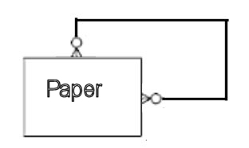
ERD Notation – Crow’s Foot
Example: Describing Prerequisites
Notes:
How about this one?
A paper may have 0 or more papers as prerequisites
A paper may be a prerequisite for 0 or more papers
This is a self-referencing relationship.
Note that the notation and interpretation is the same as always, it is just the same entity at each end.

Slide 20
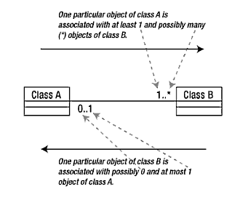
ERD Notation - UML
Notes:
The UML notation is very similar. I tend to use it in lectures because it is easier to do in Powerpoint.
Other than that, they are equivalent and you can use whatever you like
In UML, one says “class” not “entity”, but it’s the same idea
Relationships are a single line between classes
There are two symbols at each end of a relationship
The first is optionality, the second is cardinality
Optionality = 0 or 1
Cardinality = 1 or * (alternatively, ‘n’)
To convert into words, start with the far entity, as above.
You will probably encounter both CF and UML in your career. Know both, use whichever you prefer
There is also a 3rd common notation called Chen (developed by Chen) that you may see, but it is older and not so common anymore. Look it up if you are going to become a professional database guy.

Slide 21
ERD Notation
What about attributes?
Should be considered, defined and recorded.
Need not appear in an ER diagram.
Notes:
Technically, the Entity-Relationship model is the Entity-Attribute-Relationship model
As you are developing it, you probably want to be noting down the attributes, but they can be omitted from the diagram to avoid clutter

Slide 22
The Relational Model
A model to describe a relational database
Founded on the mathematical systems “relational algebra” and “relational calculus”.
Consists of
Tables
Columns
Keys
We convert our ER model (conceptual) into a relational model (logical)
Notes:
First proposed in 1970, by Codd (see I drive for seminal article, if interested)
Note that it is the relational model’s mathematical foundation that produces its robustness. The math guys are able to prove that the system works correctly when implemented correctly. Database developers and users can pretty much ignore the maths, but like knowing the physicists understand how to make airplanes stay afloat, it’s reassuring to know the formalism is there.
Note that the “table-column-key” nomenclature is database developer specific. Theoreticians may say “relationship-field” and “tuple”; DBAs may talks about “files” and “pages”. Doesn’t matter, they’re all talking about the same theoretical construct
We will review the conversion process later. It’s pretty straightforward
It involves producing necessary tables. You will recall that, while each entity in your ER model is certainly going to have some table associated with it, things can get more complex than 1-1. Some entities end up needing several tables to produce a safe and efficient database.
In addition, some new tables will have to be introduced, to represent the relationship edges in the ERD.
Also, when we convert to a relational model, we select the primary and foreign keys that support the operations of the relational algebra.

Slide 23
Relational Schema Notation
Notes:
Quite often, you will see a relational database with all its tables and keys presented as a diagram
This diagram, for example, is the database you’re going to build in today’s homework
Each box is a table, the rows in the table are attributes, the little key symbol marks the PK, the connecting lines show FKs.
But sometimes drawing a whole diagram isn’t practical, so you will see this shorthand…..

Slide 24
Relational Schema Notation
Strike(ID, Date, Time, Latitude, Longitude, Intensity)
Fire(ID, Date, Latitude, Longitude, Area)
Images(ID, StrikeID, Date, ImageFileName)
Notes:
It’s just the table name and a list of the field/column names
The primary key is underlined
Foreign keys are not underlined.
However, if you have a situation where a table’s primary key is a composite of a set of foreign keys, then all those foreign keys will be underlined.

Slide 25
SQL
SELECT | INSERT | ALTER
FROM | DELETE | TOP
WHERE | UPDATE | SUM
GROUP BY | CREATE | COUNT , SUM, etc.
HAVING | DROP | AND/OR
ORDER BY | PROCEDURE | AS
INNER JOIN | VIEW | IN/BETWEEN
Notes:
My understanding is that you have done SQL very thoroughly already in DB2, so we won’t spend a lot of time reviewing that. In a few weeks, when we are approaching application development time, we will start digging into some more advanced SQL syntax and techniques, but I am assuming you all have the basics and you will be writing some SQL today to jog your memory.
As when working with any programming language, a syntax manual will save you a lot of time. Googling also works
There are several reference pdfs on the I: drive if you need one.
These are the SQL statements that you should be really comfortable with; we will be working with T-SQL for the majority of the term, so that’s the syntax you need to remember.
Can’t get a really clear picture on how complex your join work was. If you also know outer and cross join, feel free to use them

Slide 26
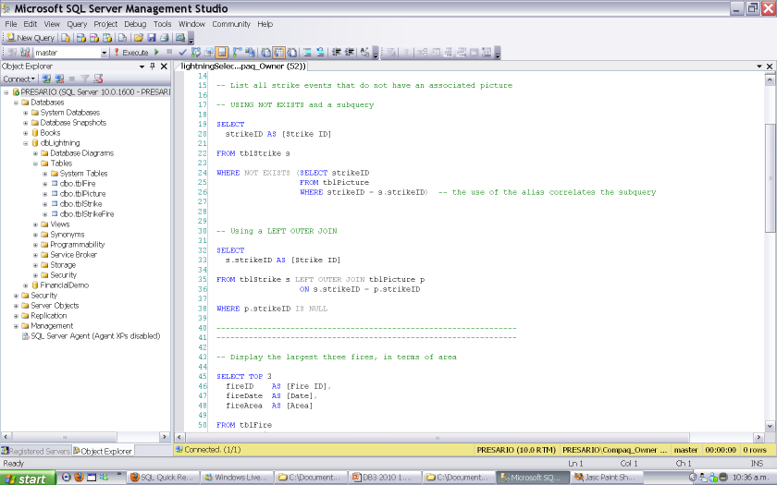
SQL Server Management Studio
Notes:
Presumably, you remember this, and know how to use the Object Explorer, how to get the Query Editor open, and how to type queries.
That’s about all you need for the moment
If not, look at the on-line help, or get a book, or get help in practical
As we proceed through the paper and learn new stuff about SQL Server, we will go through it in detail.

Slide 27
Homework
Please let Rob know BY EMAIL as soon as possible if there are any problems with your account.
Please complete the refresher assignment and commit your scripts to Gitlab before the next class session.
If you have any questions, or need any help, please feel free to ask.

